Slide 1
SAFETY RECALLS
BEFORE IT HAPPENS

Slide 2
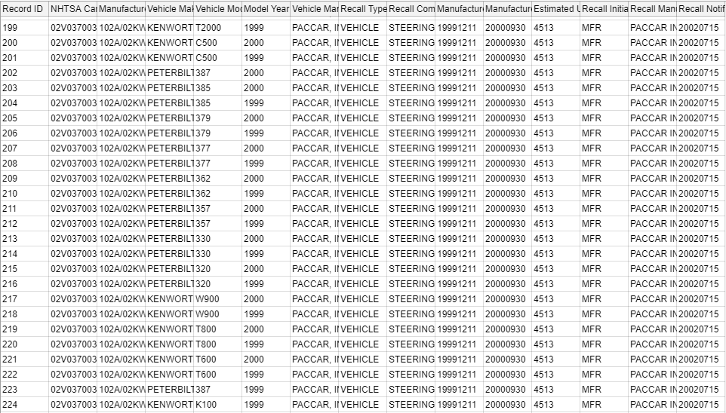
WHAT THE DATA LOOKS LIKE

Slide 3
BACKGROUND

Slide 4
If a car is discovered to have a defect, the automaker or the National Highway Traffic Safety Administration (NHTSA) attempts to contact every single owner of that vehicle and request that they bring said vehicle to a dealership for a free inspection and possible replacement of the affected parts.

Slide 5
Questions
Which Recall Type had the highest recalls
Which Manufacturer had the most recalls over time
How many Units have been recalled in total
Which model had the highest recall in total

Slide 6
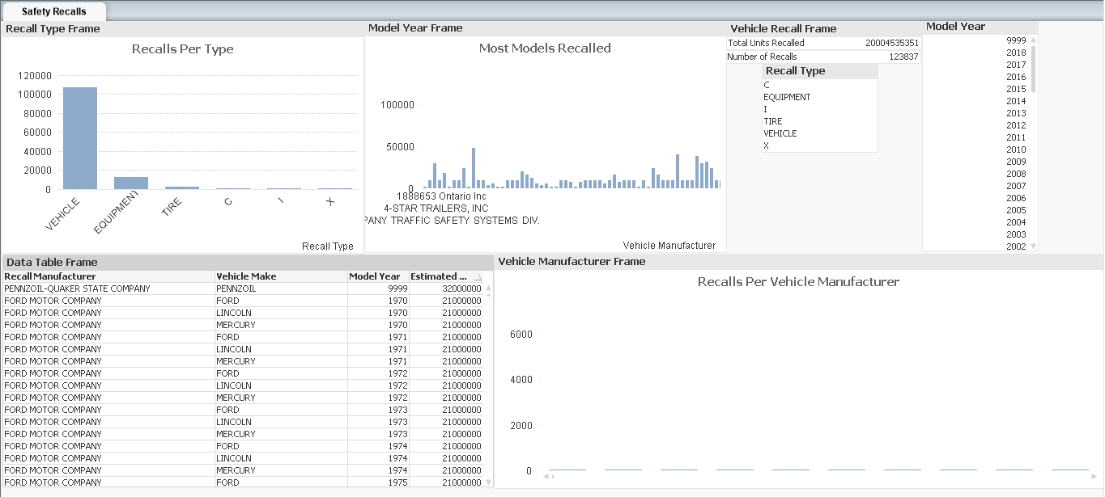

Slide 7
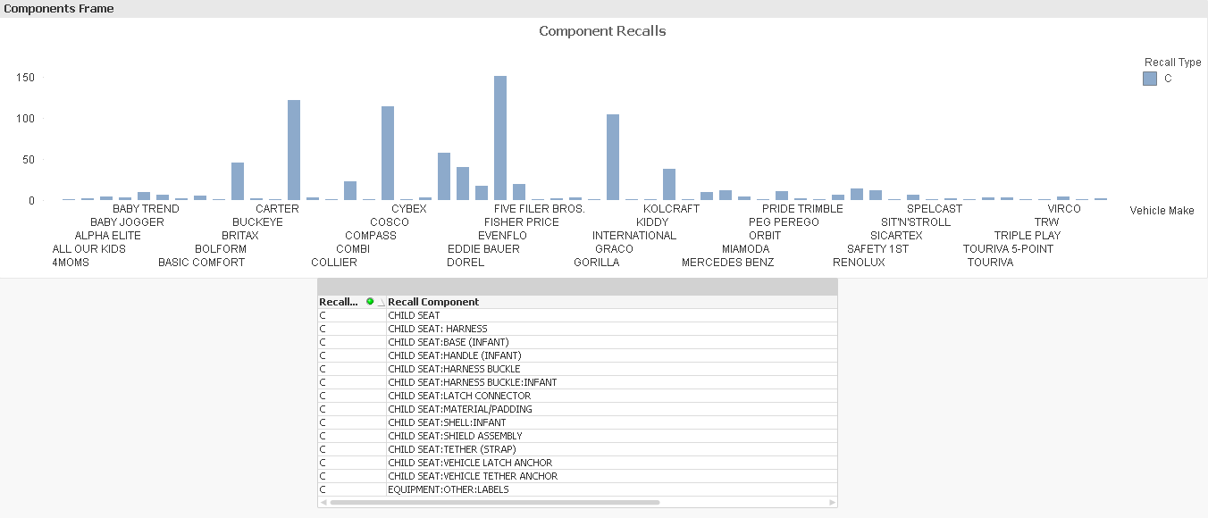

Slide 8
Conclusion
Type Vehicle has been the most recalled type
Ford Motor Company has the most safety recalls
A total of 2 Billion vehicles have been returned as safety recalls
2007 Model by all Manufacturers combined

